Slide 1

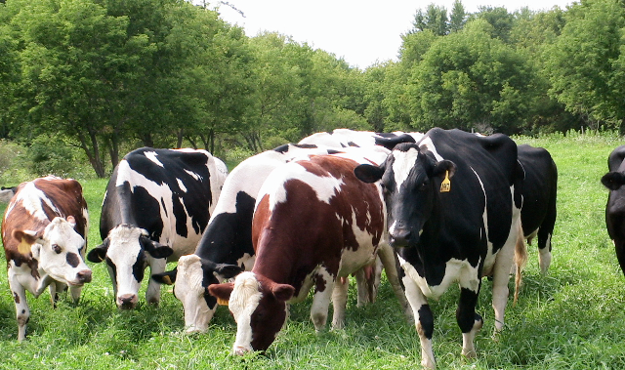
Organic Dairy for the Next Generation
Dr. Heather Darby
University of Vermont Extension

Slide 2
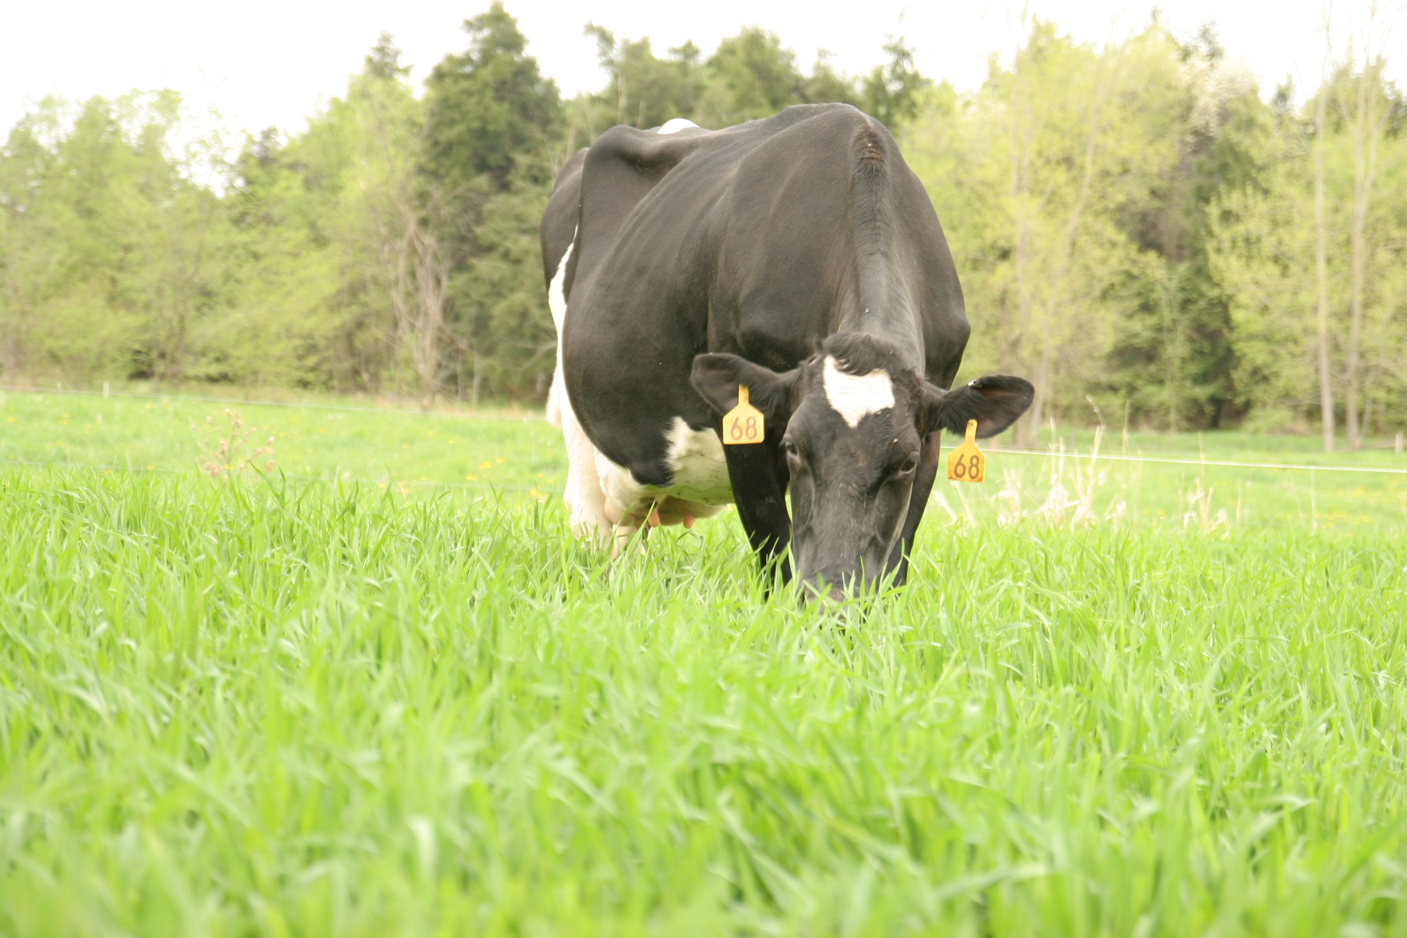
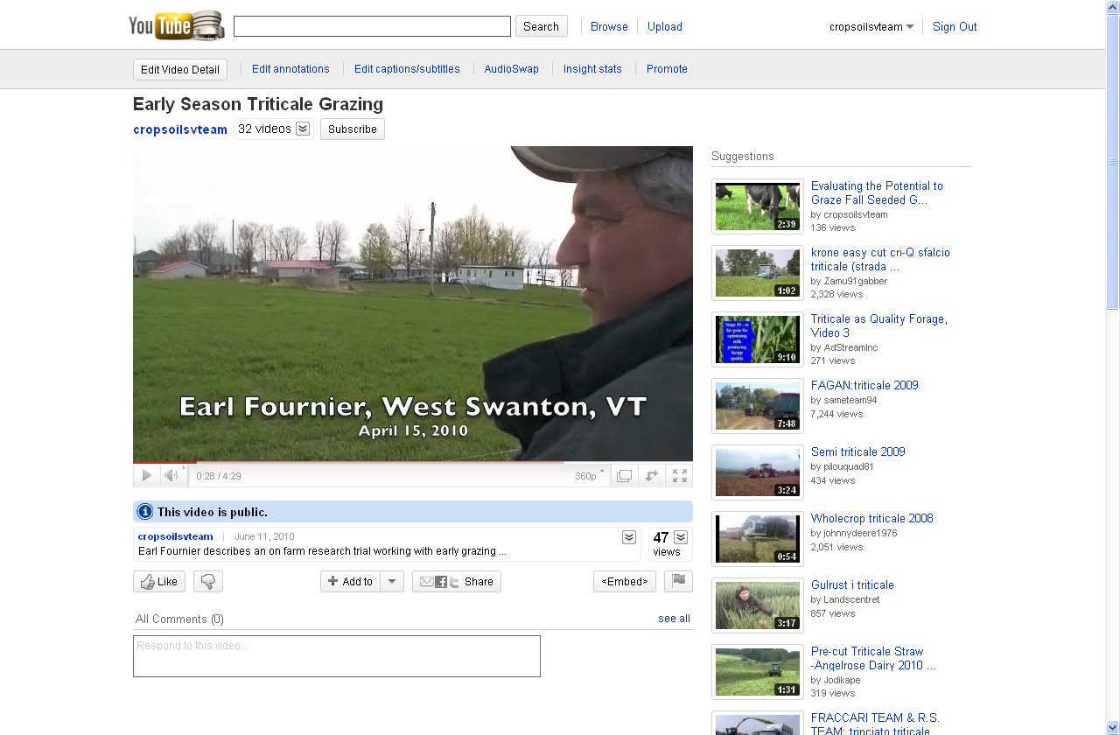
Organic dairy fast growing sector
NASS reports more than 2,030 organic dairy farms in the U.S.
201,844 certified organic cows in 2008

Slide 3
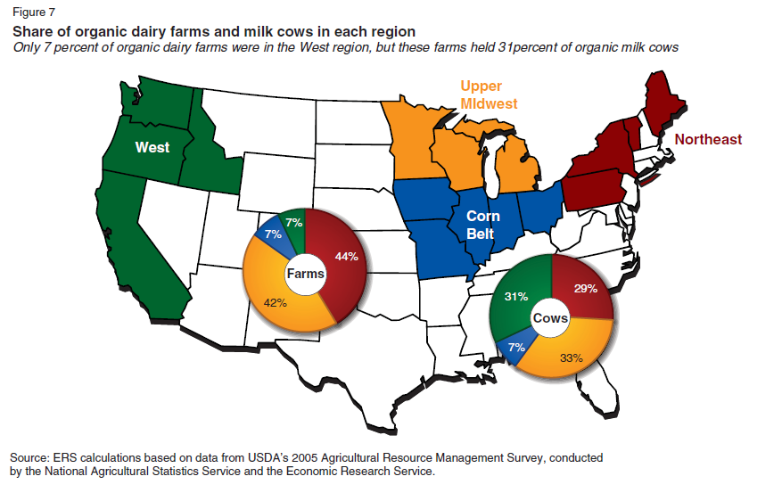
Organic dairy fast growing sector
McBride and Greene, 2009

Slide 4
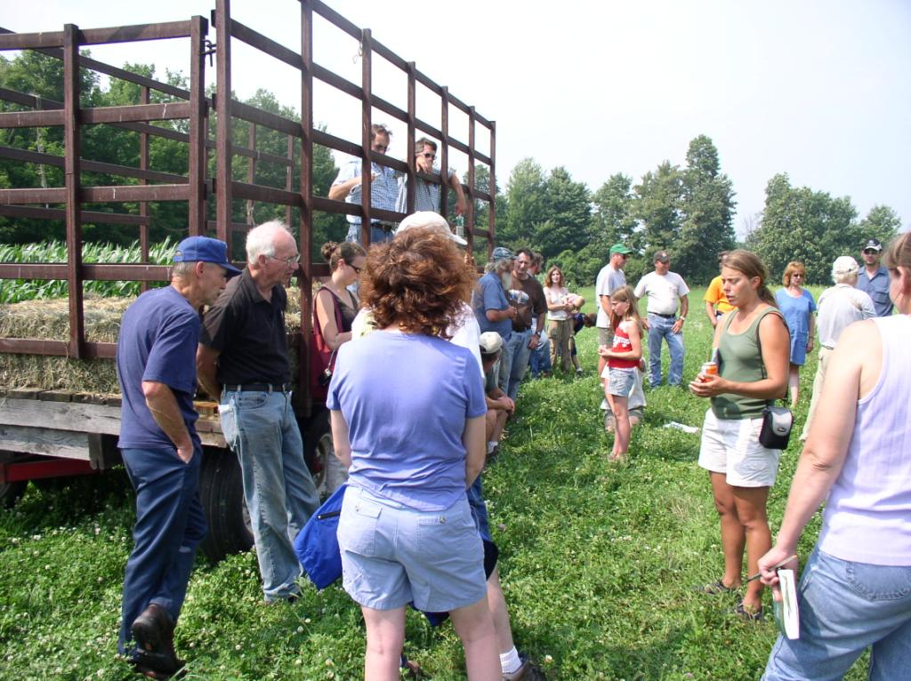

Slide 6
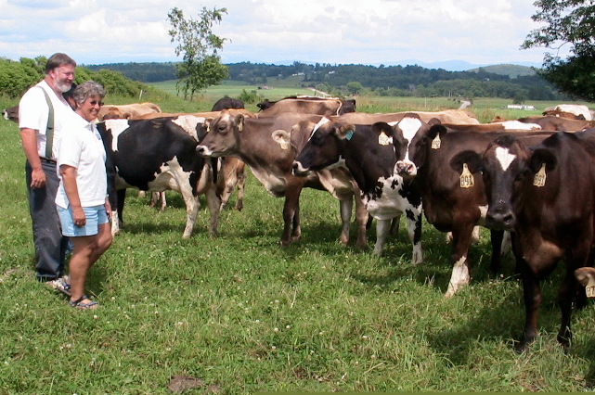
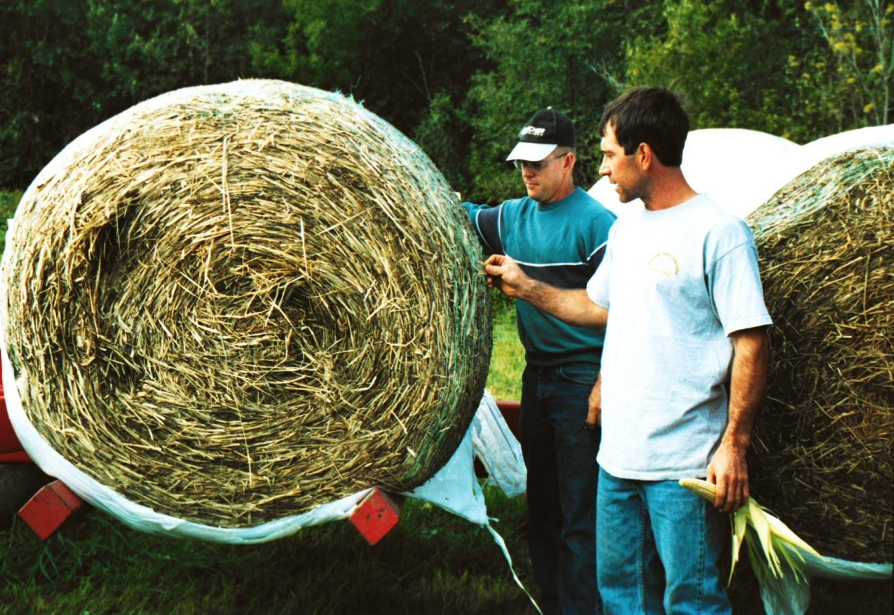
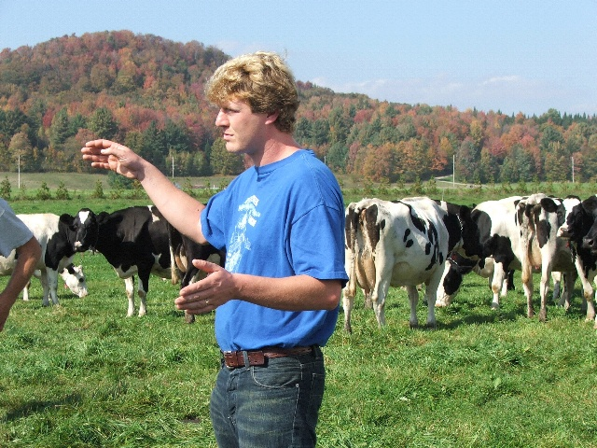
Presents opportunity for many farms to remain in business, pass on to the next generation, and even start farming!
Major contributor to rural economy
75% of organic dairy farms would not be in business today if they did not go organic

Slide 7
Few Research Dollars for ODairy
30 USDA related grants
  Primarily Hatch Funding
  Others USDA Organic Program
2 Graduate Student SARE Grants
1 SARE Agroecoystem Grant
55 Projects funded through SARE Grants
  About 50% to the Northeast (grazing)

Slide 8
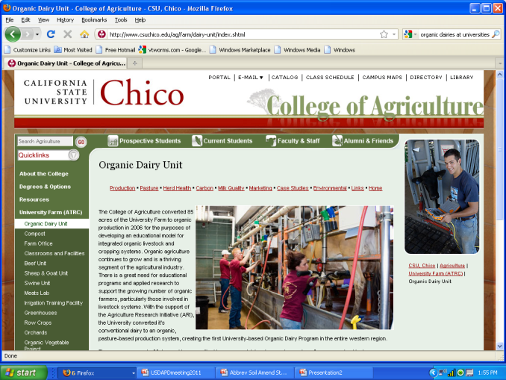
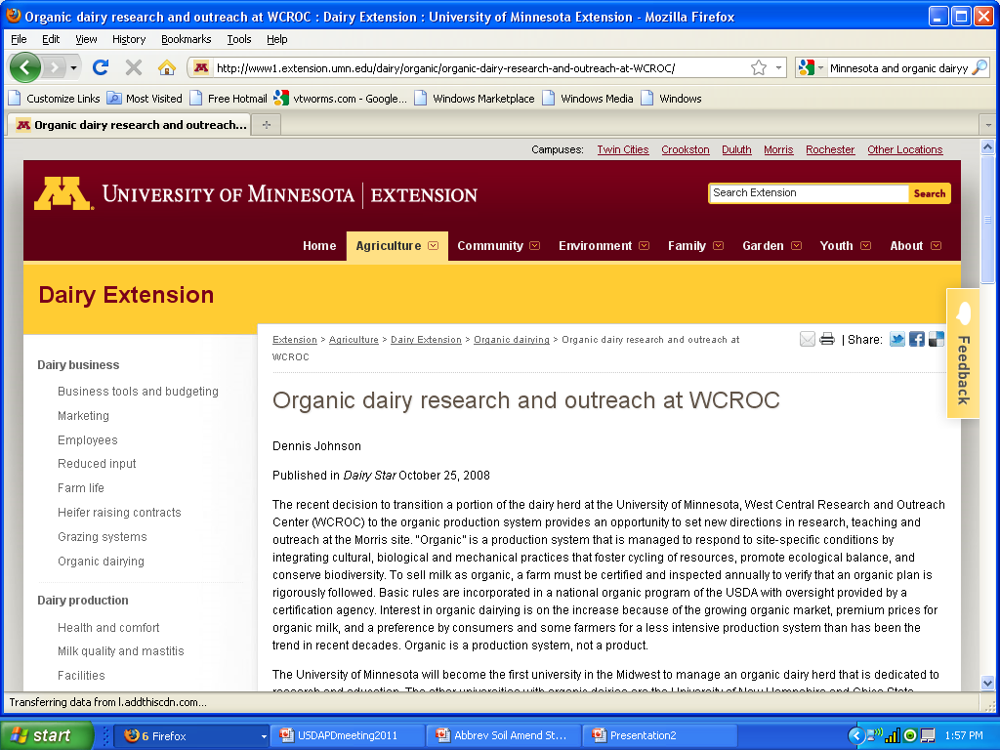
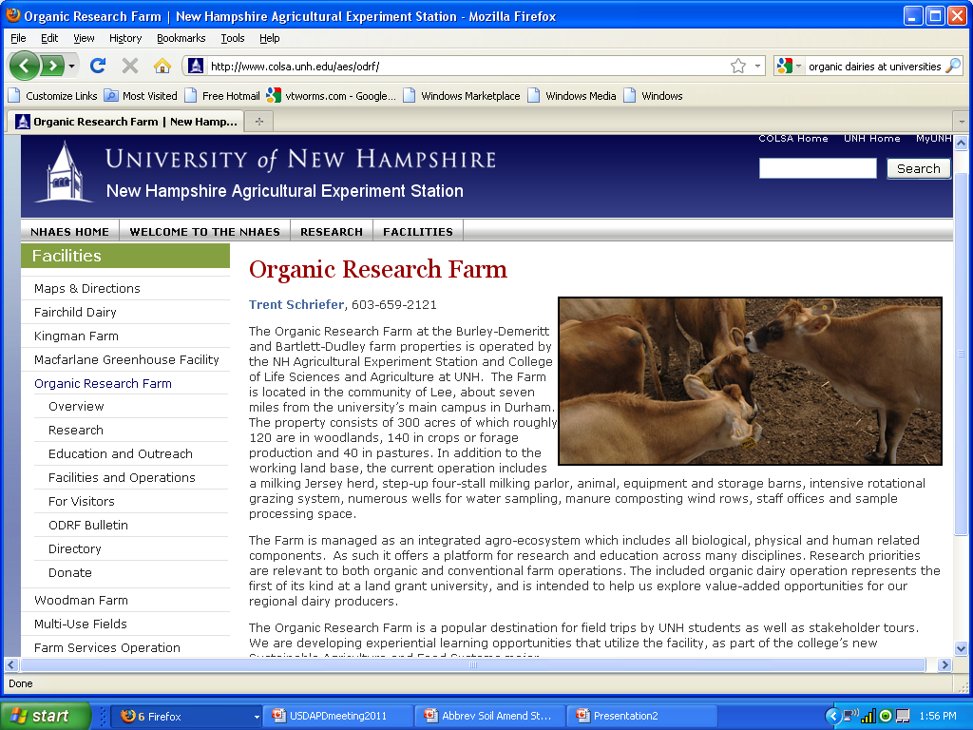
Certified Organic Research Dairy Farms

Slide 9
What research are farmers looking for?

Slide 10
Greatest Challenges
85% steady fair milk prices
  High grain prices
  Implementation of reduced quota
Greatest challenges for animal health/production
  69.0% forage quality
  59.0% fly management
  45.0% products for mastitis management
  57.0% organic trained vets

Slide 11
BUILD MORE RESILIANT SYSTEMS
Reduce input costs (especially grain)
Increase direct marketing or value add milk
Climate change
They need reliable, credible research and education to be successful in the future.

Slide 12
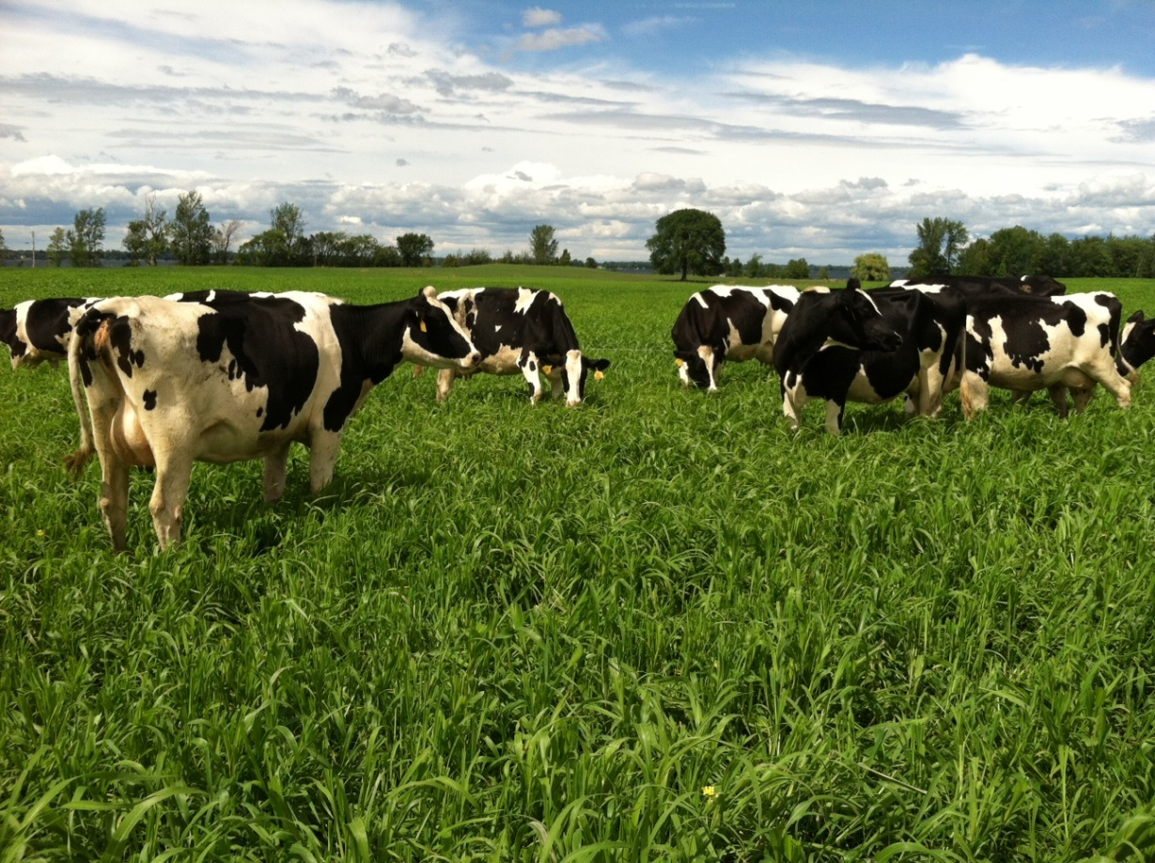

Soil
Forage
Cows
Milk
Families

Slide 13
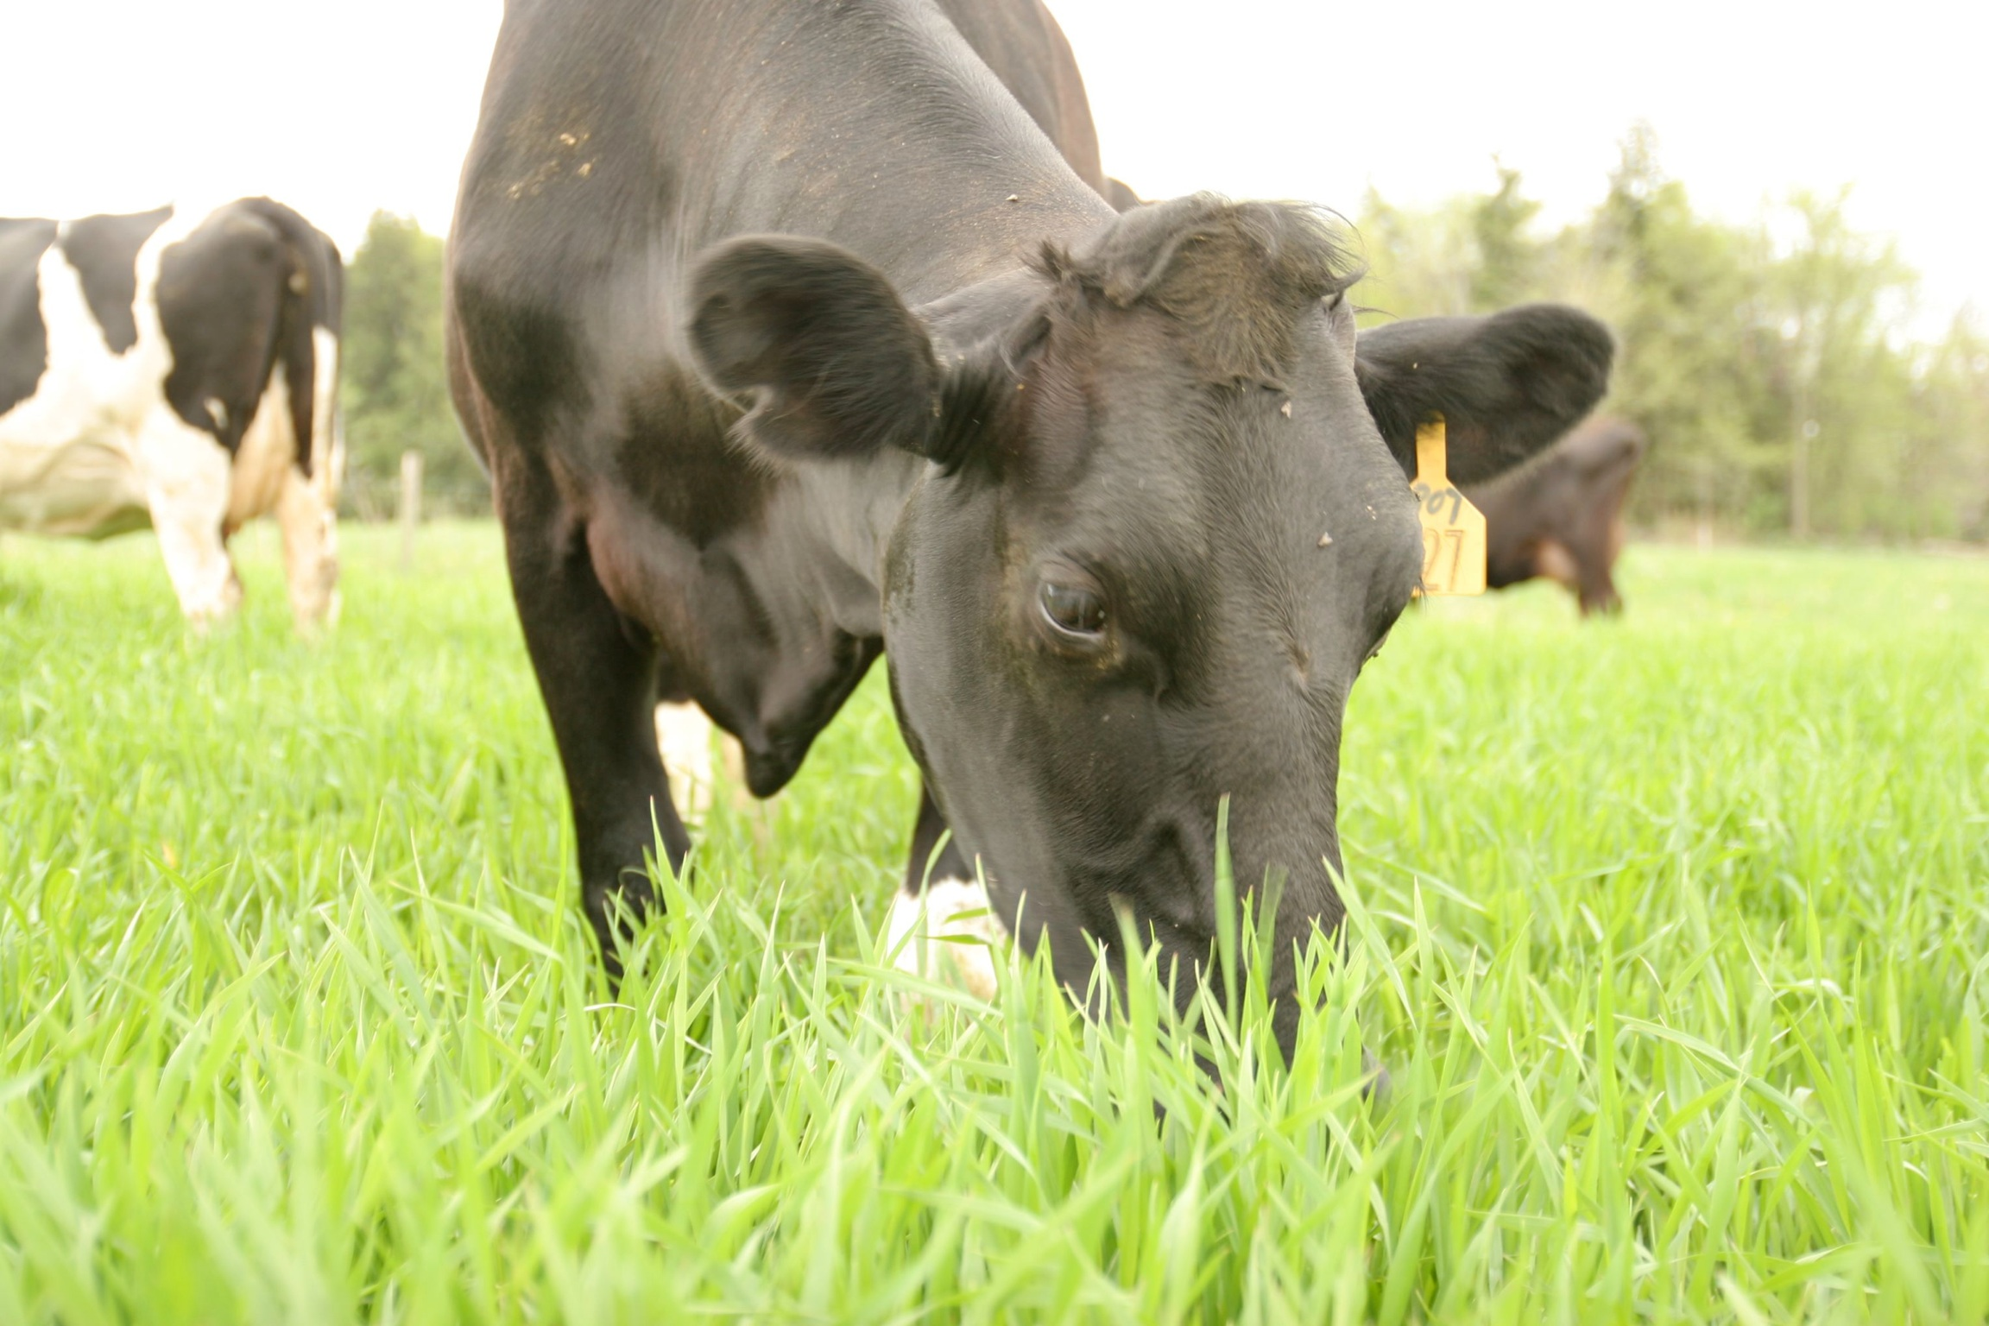
Strengthen Homegrown Feed Program to Minimize Costs, Improve Animal Health, Increase Resiliency, and Profitability

Slide 14
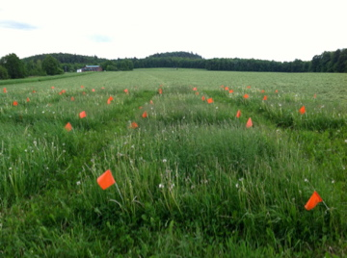

Slide 15
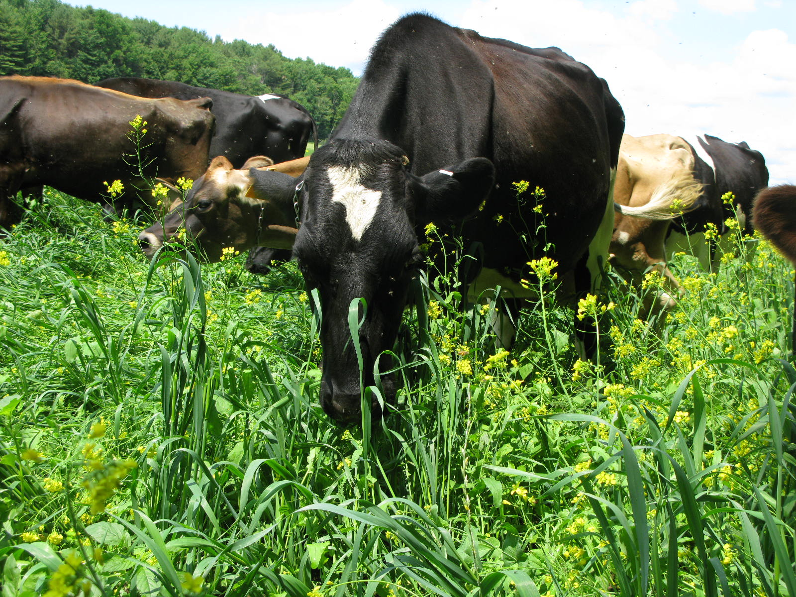

Slide 16
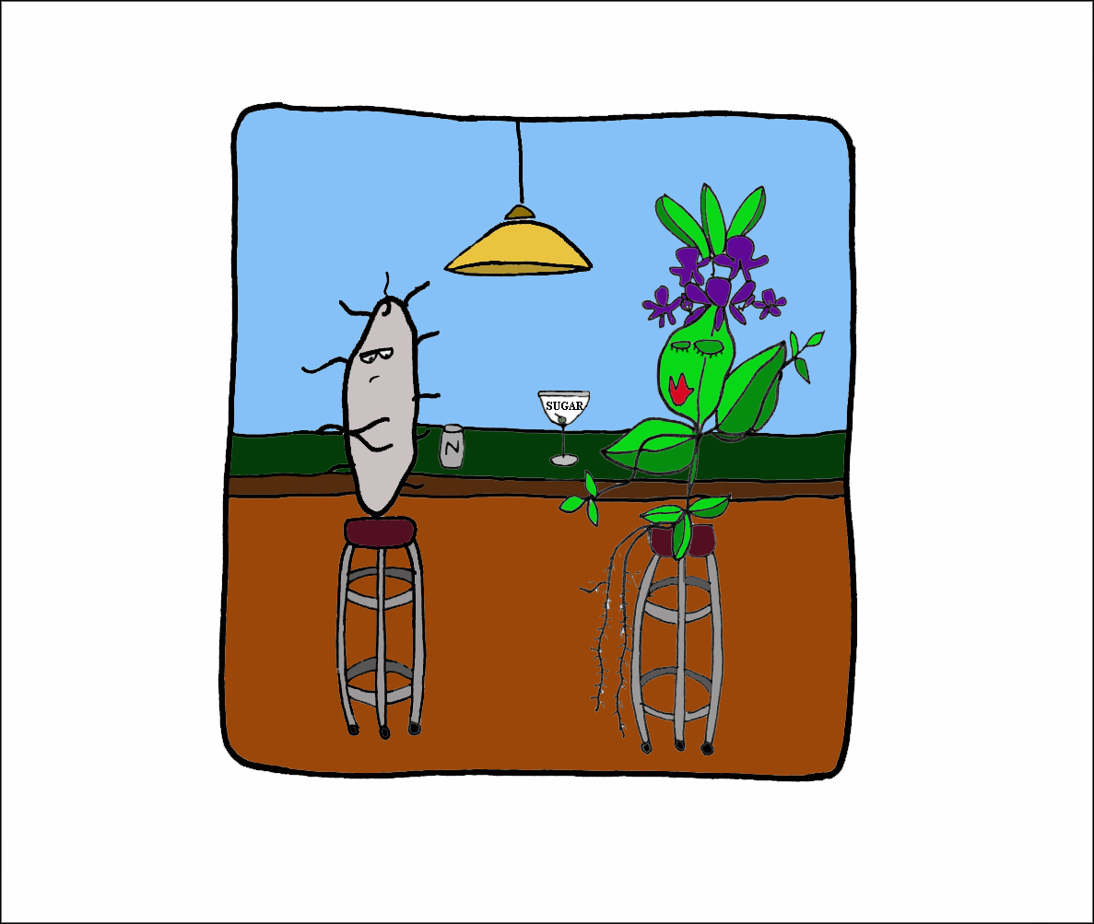
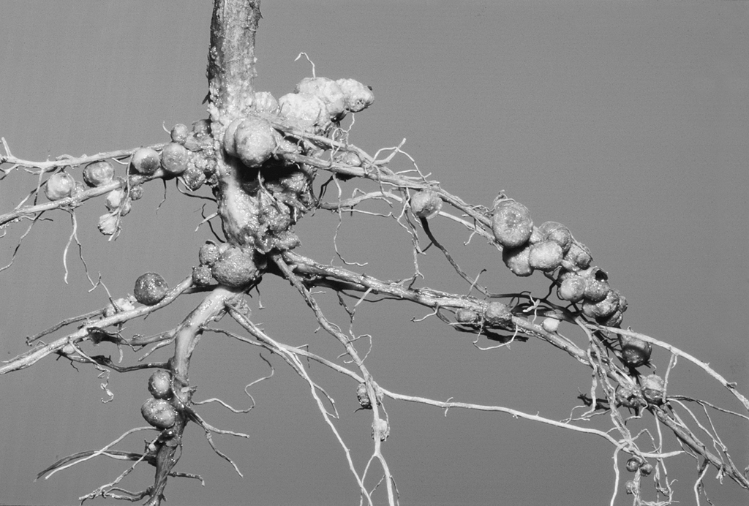
Plant - Microbial Relationships

Slide 17
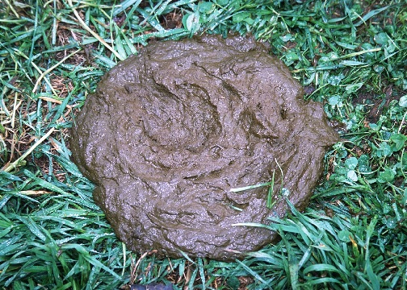

Slide 18
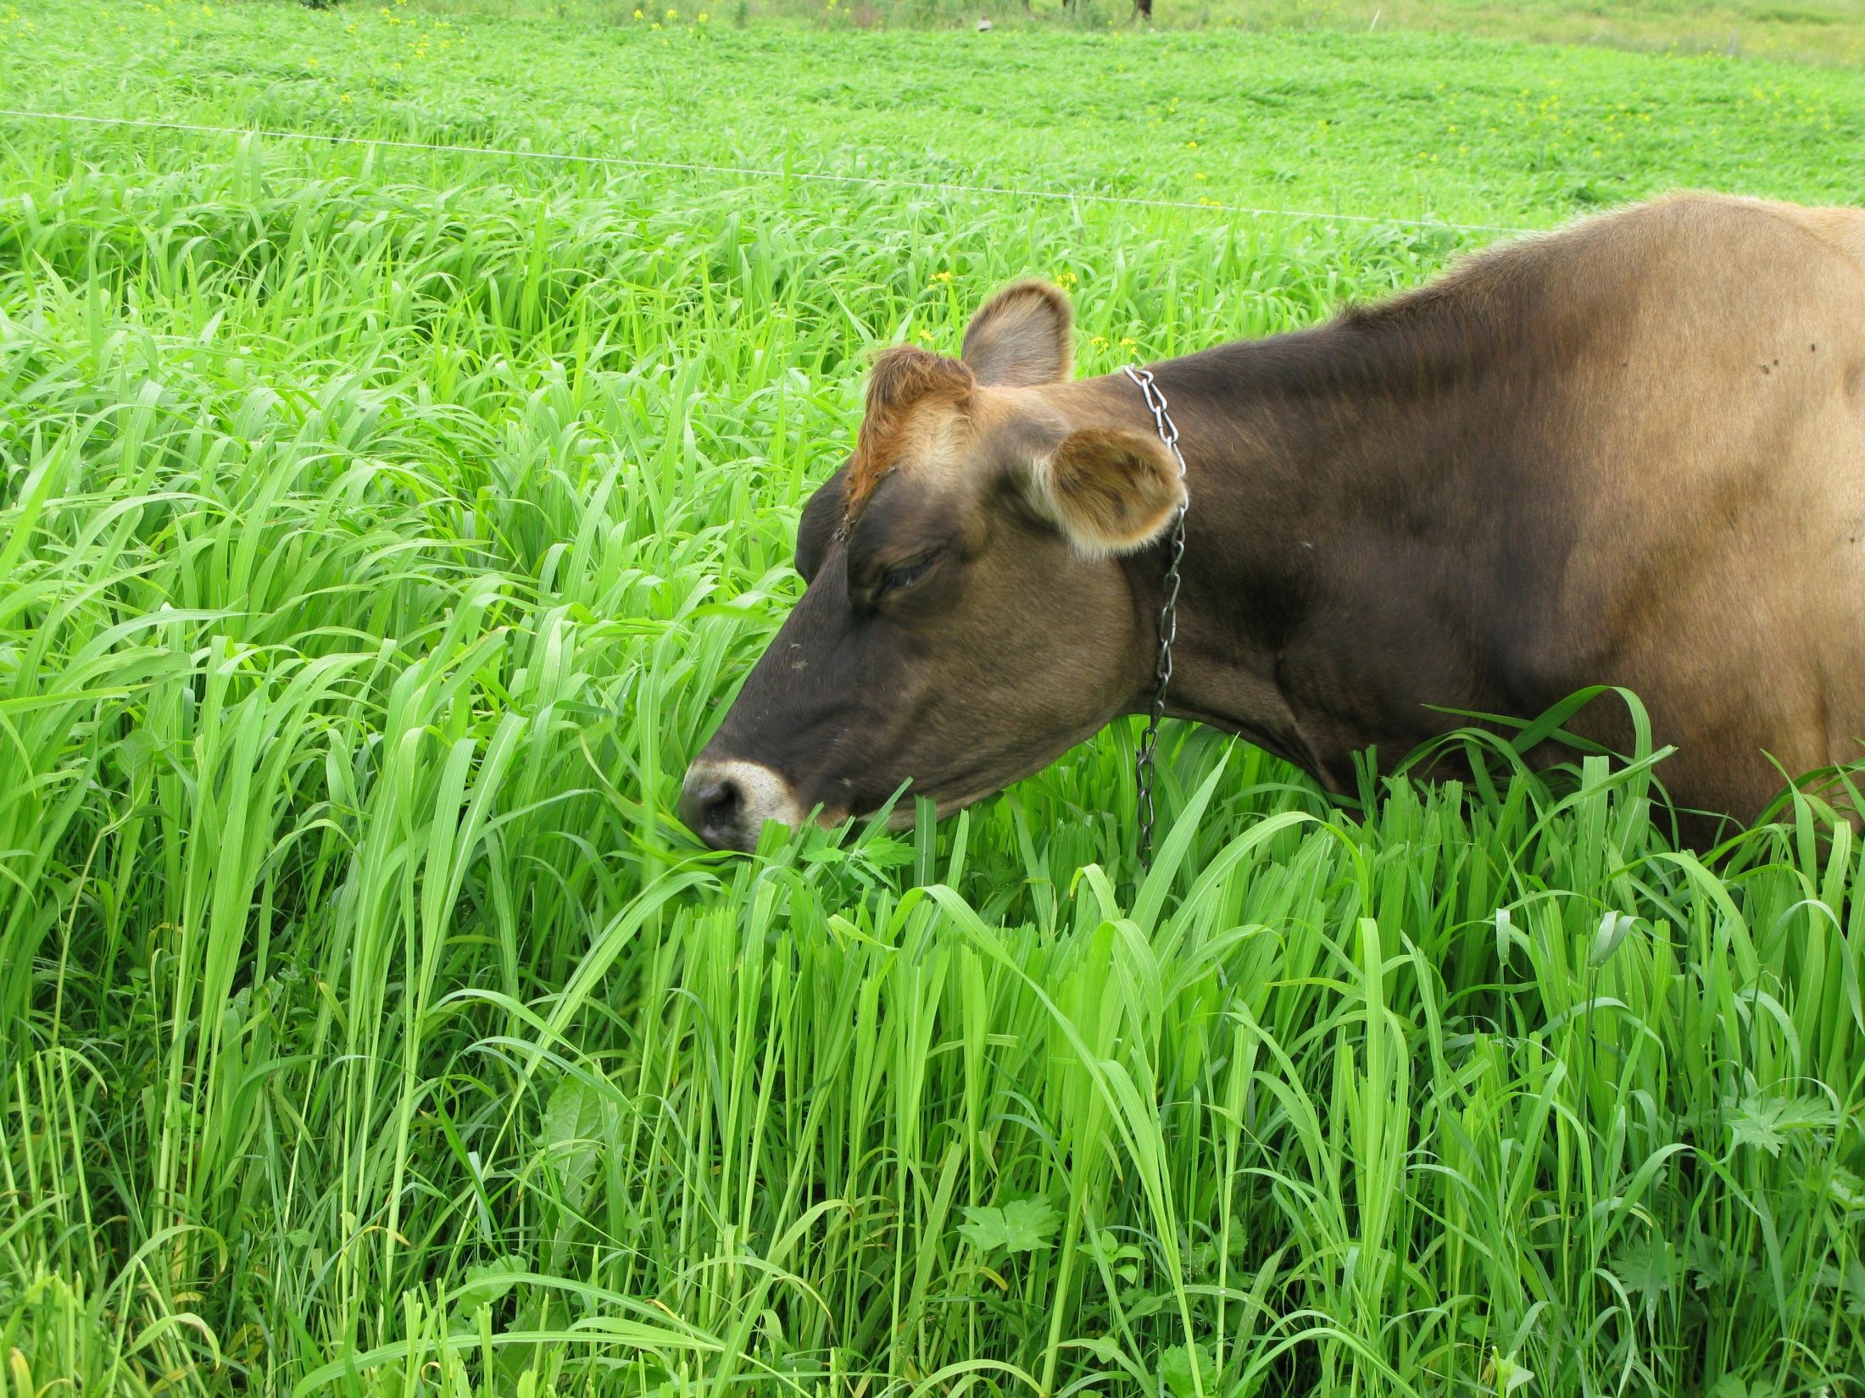

Slide 20
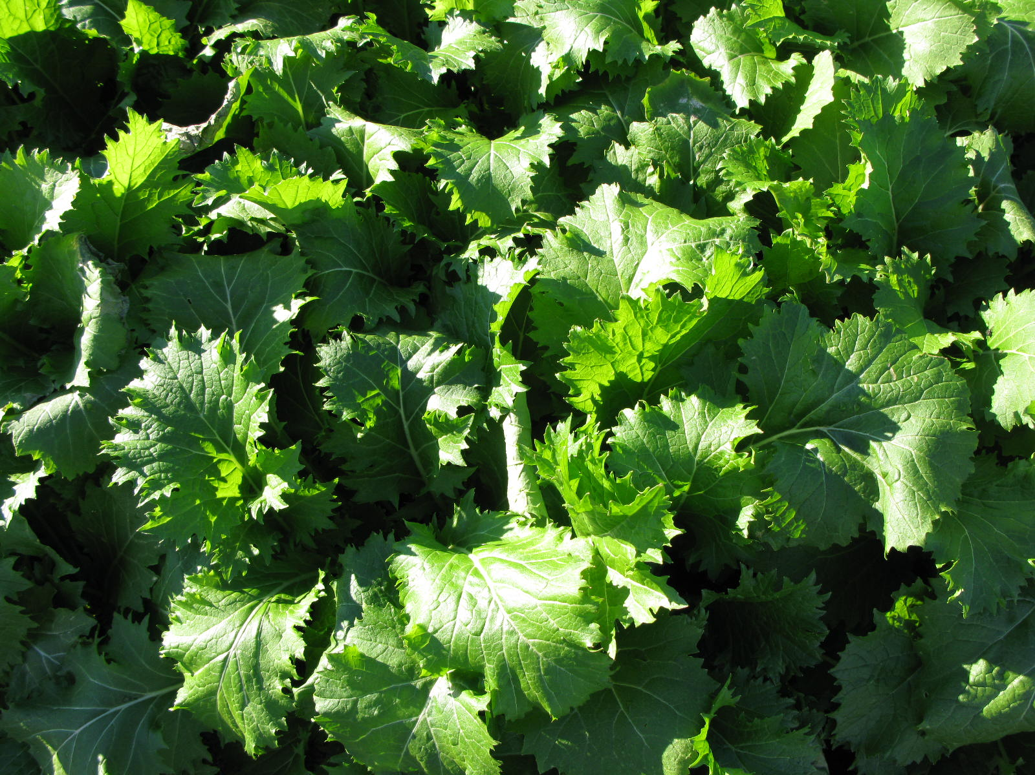
6. What are the challenges and directions for future research?

Slide 21
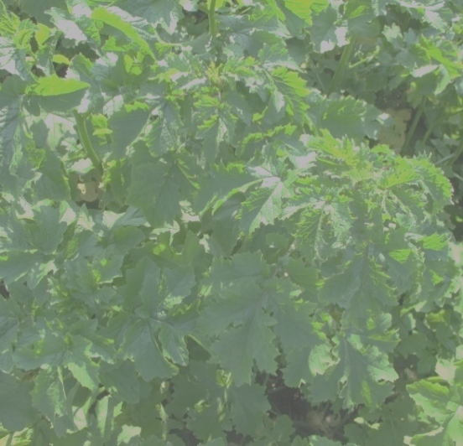
Forage Brassicas Average Yields

Slide 22
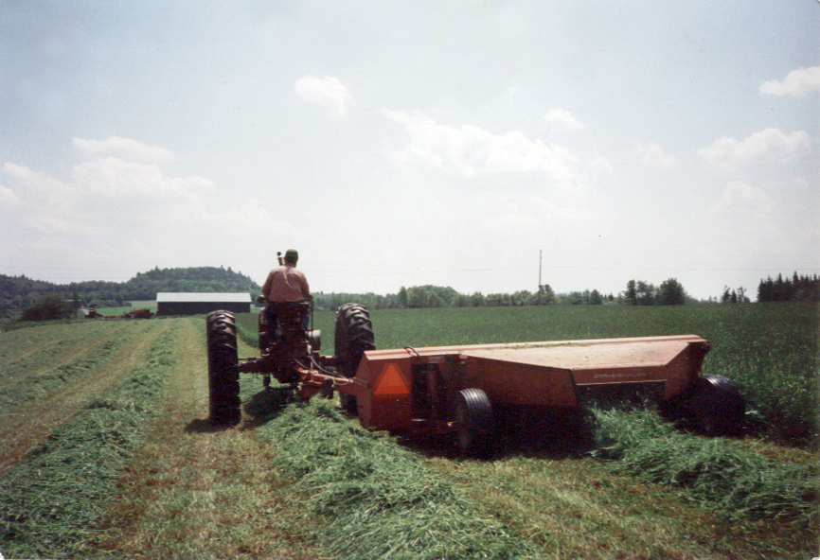

Slide 23
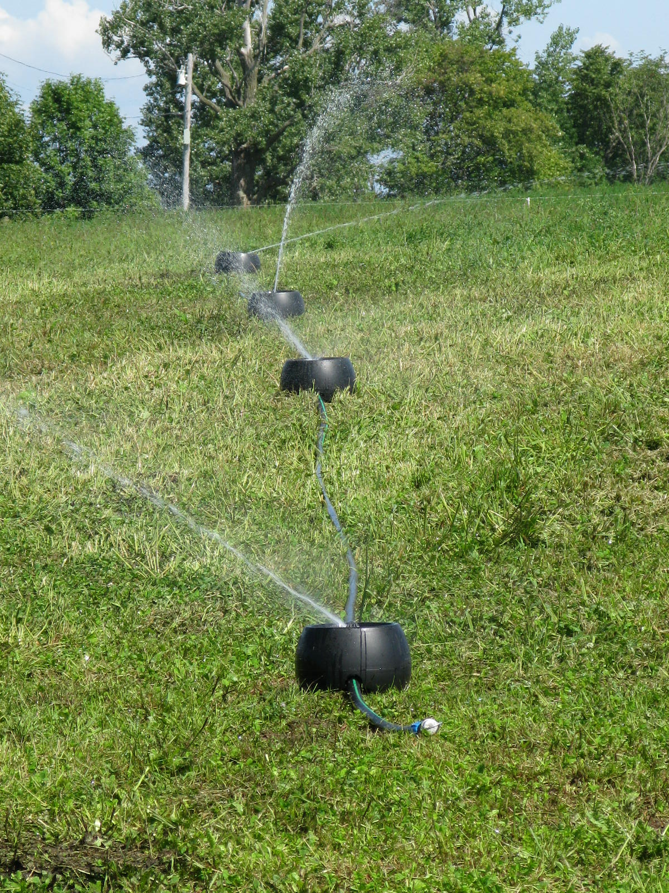
New
Strategies

Slide 24
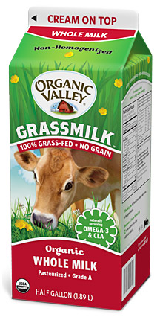
Value Added Organic
63% of farms want to add value to their milk
89% believe organic milk prices too low

Slide 25
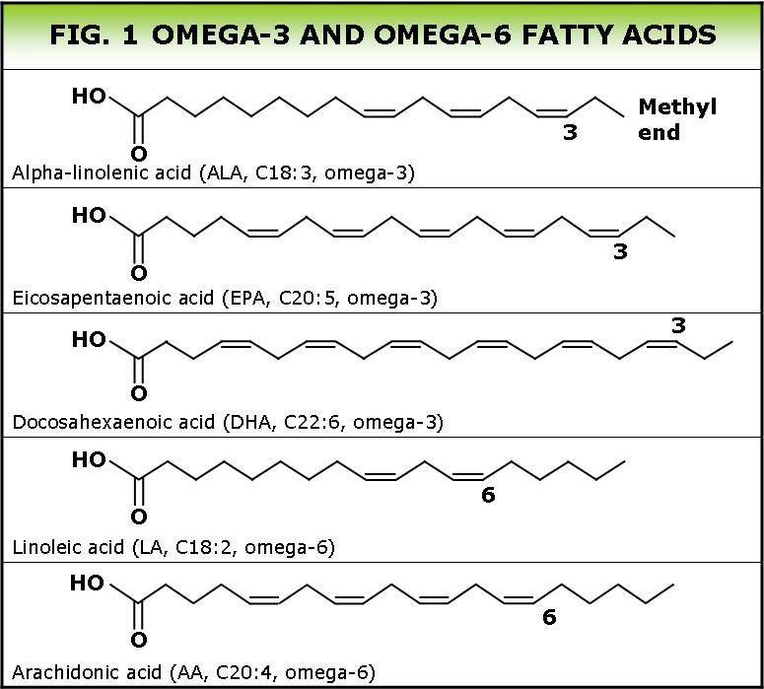
Fats

Slide 26
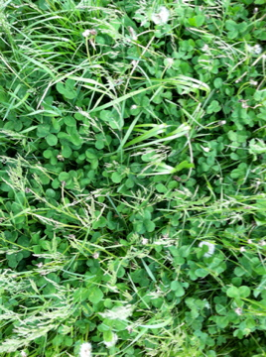
Grass |  | Omega-3
species |  | mg g⁻¹
Orchardgrass |  | 12.28
Meadow fescue |  | 12.73
Bromegrass |  | 10.46
Timothy |  | 9.63
Tall fescue |  | 11.82
Ketucky bluegrass |  | 8.23
Legume |  | Omega-3
species |  | mg g⁻¹
White clover |  | 16.52
Trefoil |  | 11.64
Red clover |  | 9.54
Alfalfa |  | 6.91

Slide 27
Summary of Omega-3 & Total Fatty Acids in Forages

Slide 28


2011 Small Grain Forage Fatty Acid Profile
Ratio Omega 6 to Omega 3 FA – 0.21
Total FA – 28.5 mg g⁻¹
Ratio Omega 6 to Omega 3 FA – 0.34
Total FA – 11.1 mg g⁻¹
Choinere Family Farm, Highgate Center, VT

Slide 30
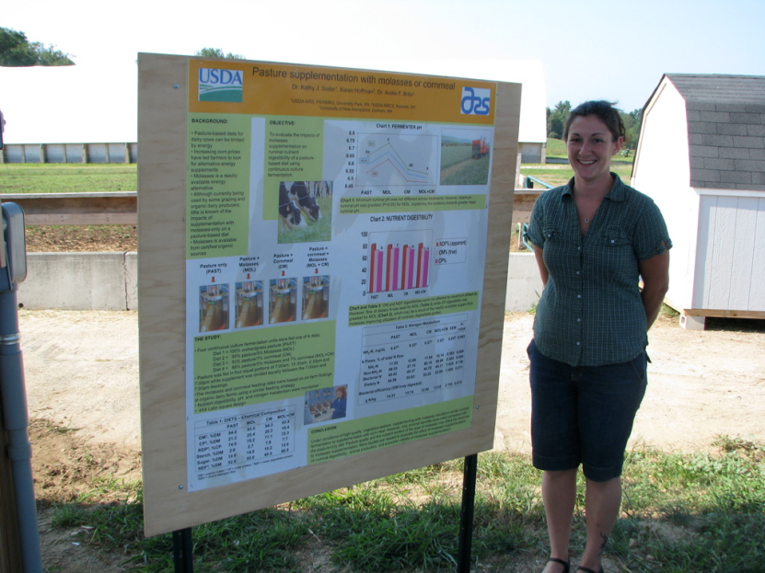
Long Term Commitment to Education of Current and Future Farmers
Private and Public Commitments to ODairy

Slide 31
Long Term Systems Research

